Slide 1
15-4=

Slide 2
11-6=

Slide 3
18-7=

Slide 4
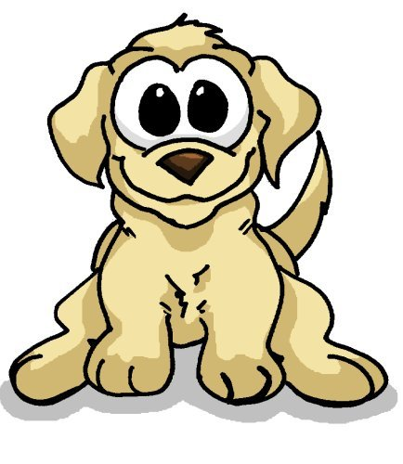
The pet store had 15 puppies. 7 of them went to live with families. How many were left?

Slide 5
Miss Owen had 20 apples. Ash Class ate 9 of them. How many were left?

Slide 6
Mrs Divers had 18 bananas. Oak Class ate 10 of them. How many were left?

Slide 7
Miss Marvin had 16 pears. Beech Class ate 8 of them. How many were left?

Slide 8
There were 14 birds in the tree. 6 flew away. How many were left?

Slide 9
There were 13 ladybirds on the leaf. 5 flew away. How many were left?

